Slide 1
SVGs
Scaleable Vector Graphics

Slide 2
What exactly is SVG
Scaleable vector graphics.
a language for describing 2d graphics.
Generative Modelling Language (GML) is used for 3D graphics
XML for web graphics
Notes:
XML – extensible markup language

Slide 3
Uses
Icons
Visualizations
Responsive images(but not like how flex box/bootstrap is for CSS)
Banner ads
Animations etc

Slide 4
Scaleable
As the name suggests, its scalebale
Can be scaled indefinitely.
Graphically Independent
Unlike SVG, raster formats like jpeg and png are resolution dependent.
Notes:
raster graphics, also called bitmap graphics, a type of digital image that uses tiny rectangular pixels, or picture elements, arranged in a grid formation to represent an image.

Slide 5
Text based
Like XML.
Lesser storage
-ex. for a png image of 5kb, the corresponding svg image will probably be of 2kb
When svg image opened in a text editor like brackets, VS or sublime, you will be greeted with code. When a png image is opned, you will find the picture.
Image is based on code rather than photo editor/ software like paint or camera(.jpeg).
Can be embedded with HTML on webpage/ website

Slide 6
Dynamic
Since it is text based, it is apart of DOM
Every element is directly accessible i Javascript.

Slide 7
Viewport vs Viewbox
Viewport is infinite
There are no restraints on the codinate system
In viewport, origin of SVG universe is 0,0.
Viewbox is area of canvas displayed on viewport

Slide 8
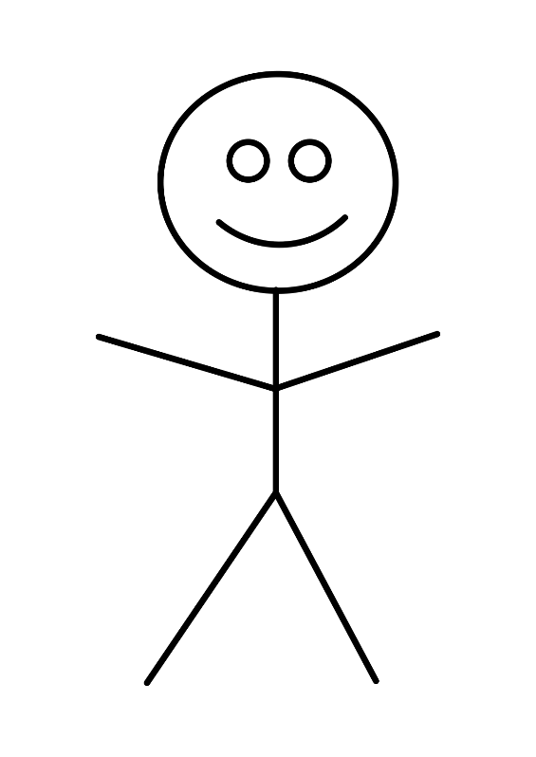
Lets make a stick figure together using svg

Slide 9

Assignment 1
Make Captain America’s Shield using svg

